Slide 1

DEPARTMENT OF COMPUTER SCIENCE AND ENGINEERING
MINOR PROJECT FINAL REVIEW ON
PILL REMINDER SYSTEM
PRESENTED BY:
V. Aakanksha(21UP1A05C9)
A. Amulya Rachel(21UP1A0568)
K. Laxmi(21UP1A0595)
(BATCH 12)
UNDER THE GUIDANCE OF:
Mr. S.Chandra Sheker

Slide 2
CONTENTS
ABSTRACT
INTRODUCTION
EXISTING SYSTEM
PROPOSED SYSTEM
SYSTEM ARCHITECTURE
SYSTEM REQUIREMENT
METHODOLOGY
UML DIAGRAMS
IMPLEMENTATION
RESULT
FUTURE SCOPE
CONCLUSION

Slide 3
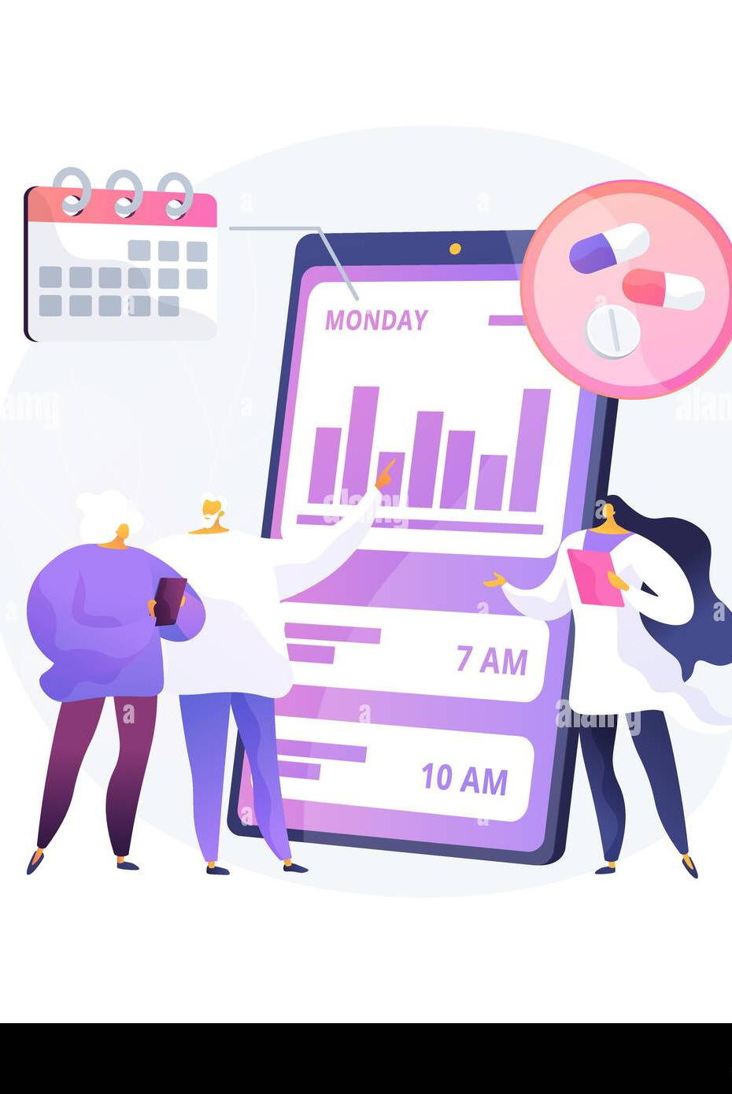
ABSTRACT
The Pill Reminder System is an Android-based mobile application designed to assist users in managing their medication schedules effectively. Built using Java and Android Studio, the application incorporates features such as user authentication (sign-in and sign-up), scheduling medicine reminders, maintaining pill counts, generating refill alerts, and storing user medical reports.

Slide 4

INTRODUCTION
The Pill Reminder System is designed to improve medication adherence by providing timely reminders and tracking consumption patterns.
This system aims to simplify the process and ensure consistent drug intake.
It also features customizable settings to accommodate various medication regimens, allowing users to specify dosages, times, and additional notes.
Recognizing the need for an effective solution, the Pill Reminder System is designed to provide a reliable and user-friendly way to help users adhere to their prescribed medication schedules

Slide 5
EXISTING SYSTEM
Time-Based Reminder: These are simple reminder systems that notify users to take their medications at scheduled times.
Customizable reminders : The reminders can be customizable according to the user requirements i.e daily, weekly, or monthly.
Pill count: It stores no of pills added during login and updates regularly
DRAWBACKS
No Voice Reminder functionality
No Refilling of Pill Reminder functionality
No Storing Medical Reports functionality

Slide 6
PROPOSED SYSTEM
Verbal Reminder : Introducing an Android application whose objective is to remind the patients of their dosage timings through Alarm Ringing System along with a voice message
Stores Reports : This application also Stores the medical reports of the patient
Reminder to refill the pills : This system will also send a reminder to the user to refill pills when the count is low
ADVANTAGES
Every One Can Access Easily
User Can Access Their Reports Anytime
Avoids Shortage Of Pills

Slide 7
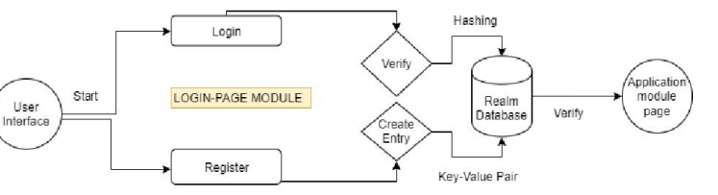
SYSTEM ARCHITECTURE

Slide 8
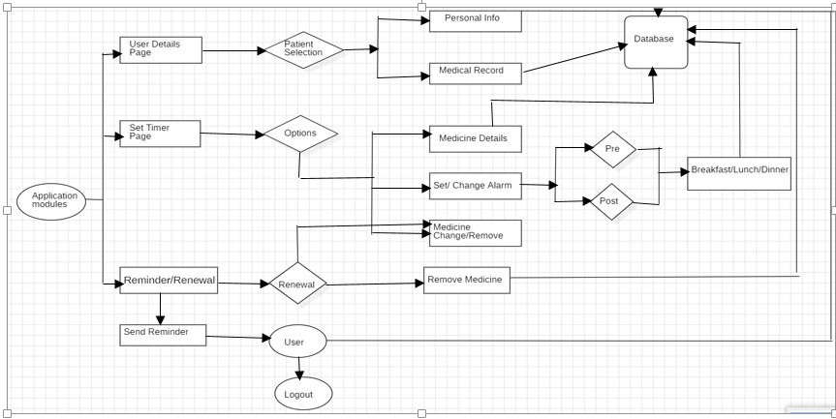
SYSTEM ARCHITECTURE
Store/fetch
Store/fetch
If need
No need

Slide 9
SYSTEM REQUIREMENT
1.Functional Requirements:
Medication Management:
Storage
Scheduling
Reminders
Pill Count Tracking
Communication:
Emergency Contacts
User Interface
Data Security
2.Non-Functional Requirements:
Performance
Reliability
Usability
Maintainability
Scalability
Portability
3.Technical Requirements
Hardware
Software
Connectivity

Slide 10
METHODOLOGY
RESEARCH
Health Databases: To gather information about medication schedules and types of pills.
User Surveys: To understand user needs for features like alarms, notifications, and data privacy.
Medical Guidelines: To ensure accurate timing and reminders for various medications.
PLANNING & DESIGN
System Architecture Design: It focusing on defining, organizing, and integrating the components
UI/UX Design:XML in Android is used to define layouts, styles, and UI components for the app.
Functional Design: According To The Requirements Core Features Are Designed
DEVELOPMENT
According to the requirements and planning the functionalities are developed by using Java
DEPLOYMENT AND MAINTANENCE
Publish app on app stores (Apple App Store, Google Play Store)
Monitor app performance and analytics

Slide 11
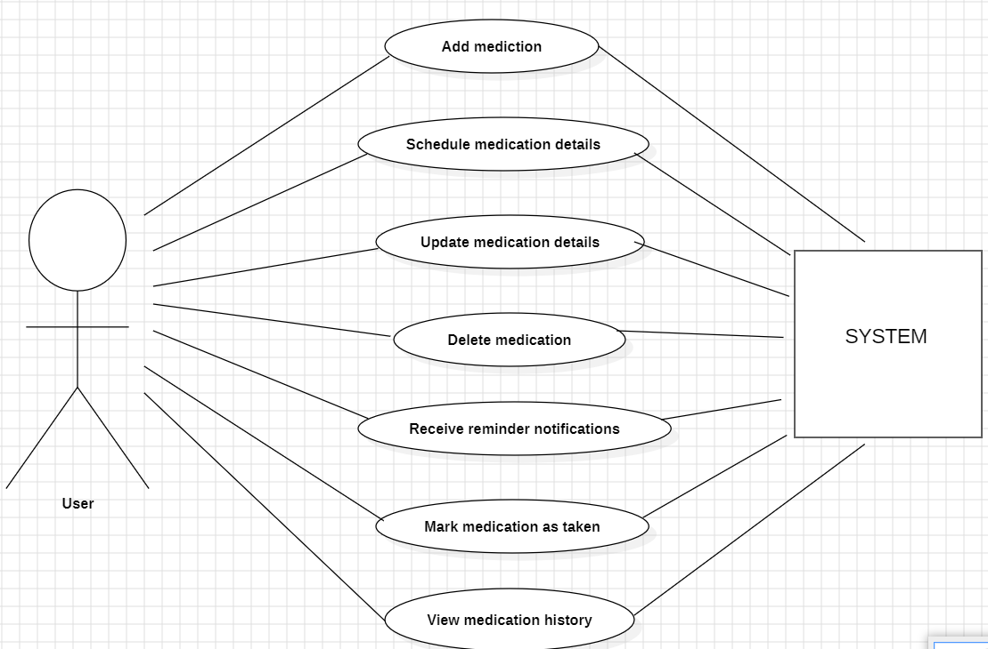
UML DIAGRAMS
USE CASE

Slide 12
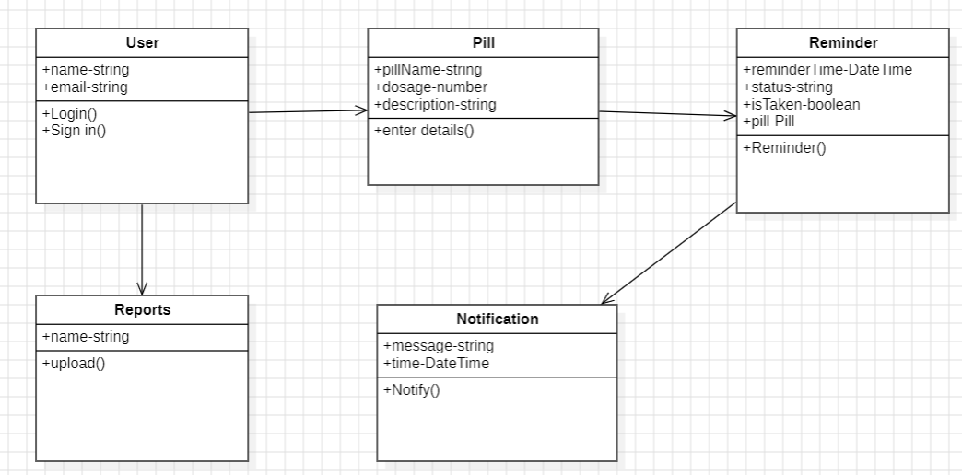
UML DIAGRAMS
+Register()
CLASS DIAGRAM

Slide 13
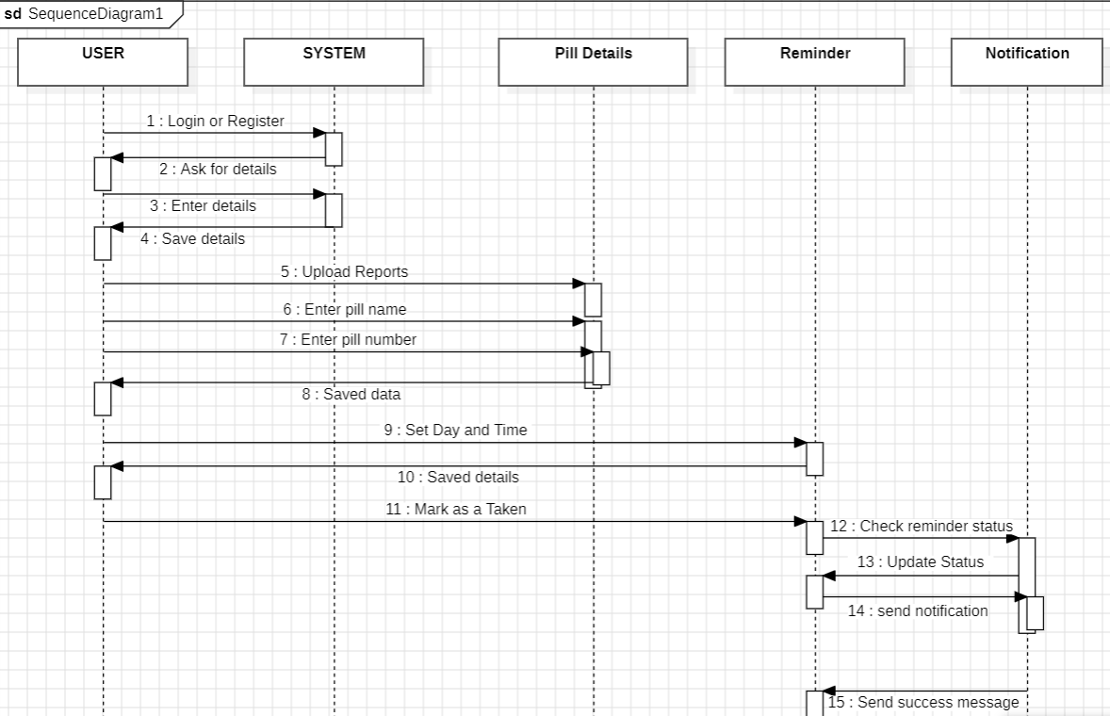
SEQUENCE DIAGRAM

Slide 14
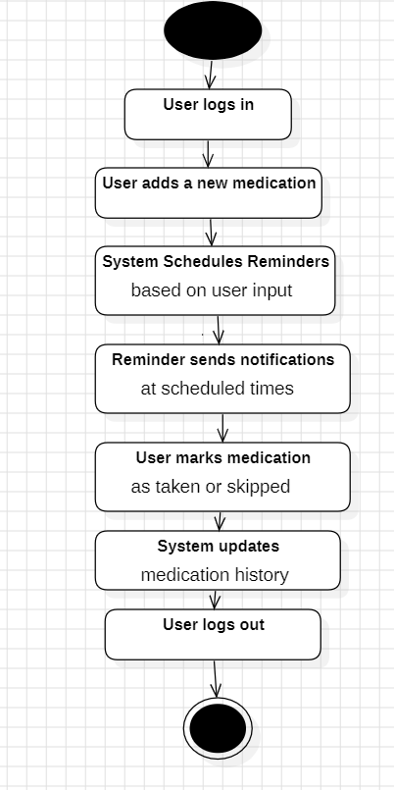
ACTIVITY DIAGRAM

Slide 15
IMPLEMENTATION
STEP BY STEP ALGORITHM FOR PILL REMINDER SYSTEM
STEP 1: Login or Sign Up
STEP 2: Enter your details
STEP 3: Upload your health reports
STEP 4: Enter the details of the pill
STEP 5: Schedule the time of the pill to be taken
STEP 6: Check the pill count regularly
STEP 7: Update the reports regularly
STEP 8: Logout

Slide 16
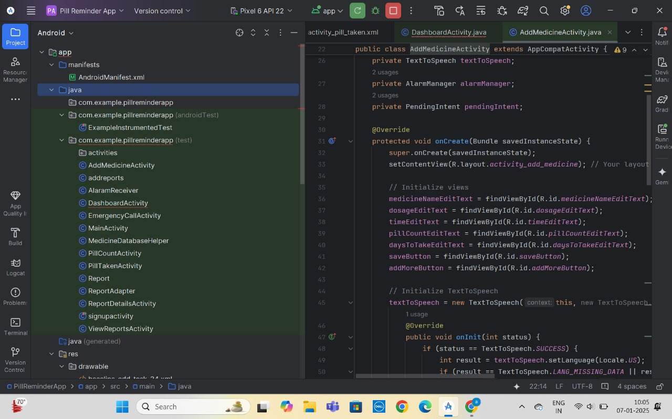
IMPLEMENTATION

Slide 17
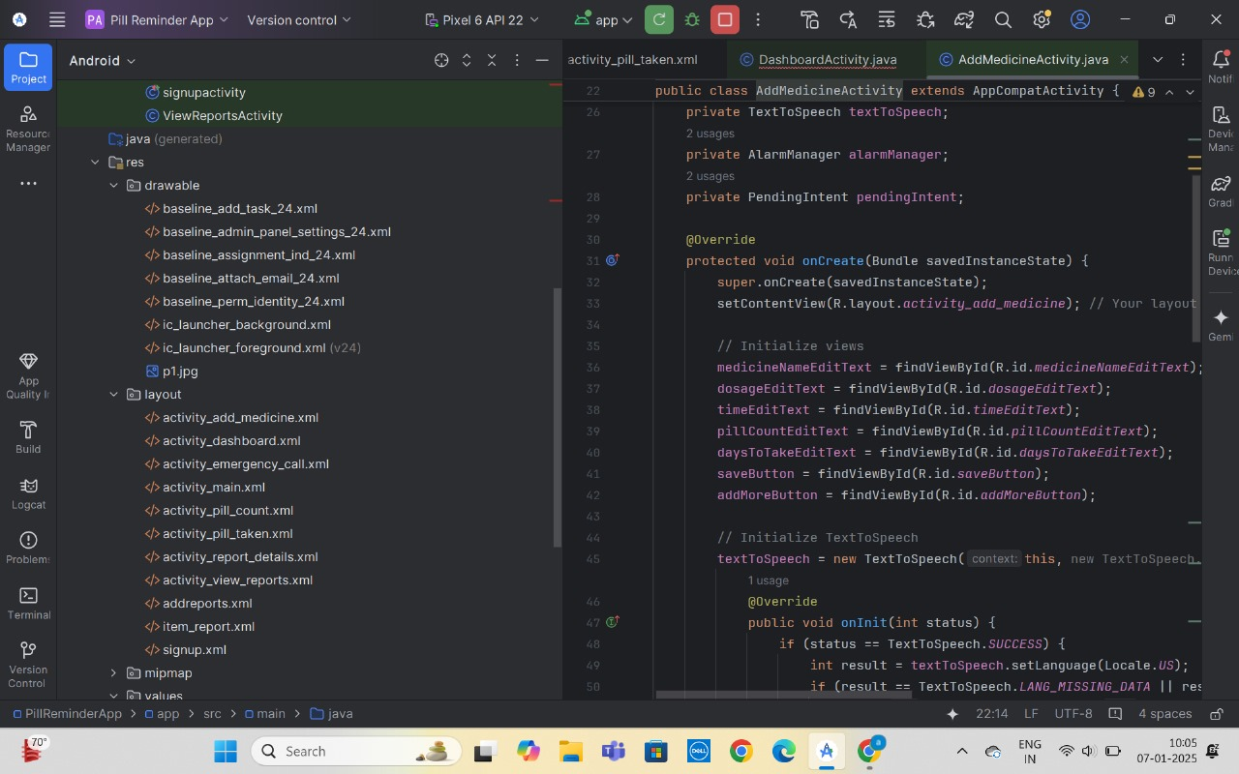

Slide 18
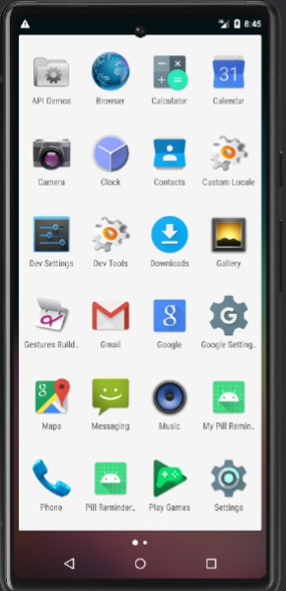
RESULT:
DISPLAY OF APP

Slide 19
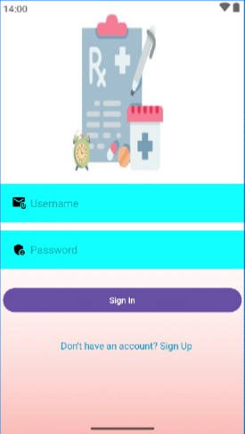
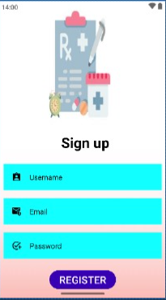
SIGN IN PAGE
SIGN UP PAGE

Slide 20
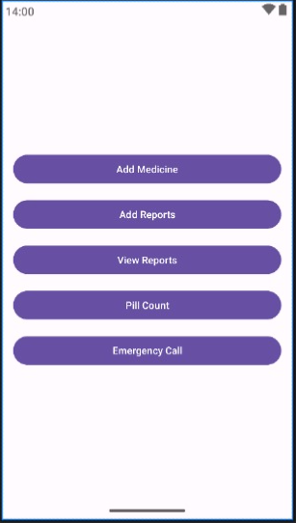
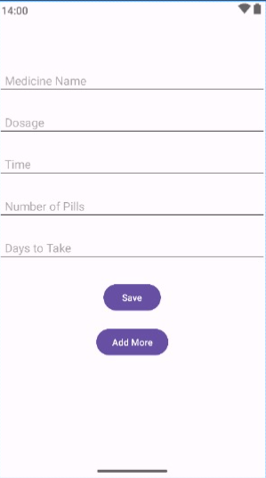
DASHBOARD
ADD MEDICINE PAGE

Slide 21
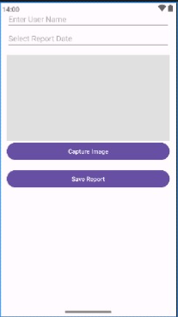
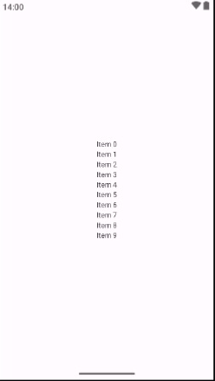

ADD REPORTS PAGE
VIEW REPORTS
DETAIL REPORTS

Slide 22
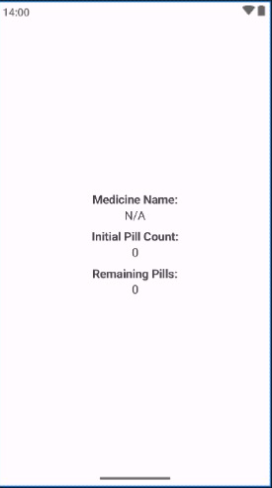
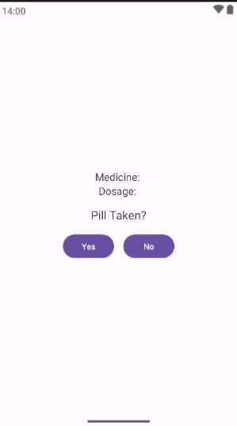
PILL COUNT PAGE
ALARM PAGE

Slide 23
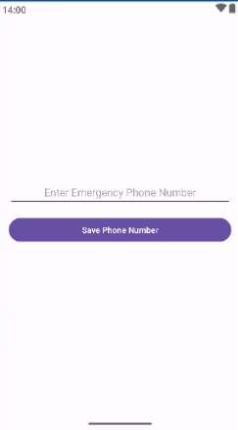
EMERGENCY CALL PAGE

Slide 24
Future Scope
1. Enhanced Personalization & AI Integration:
Predictive Scheduling
AI-Powered Dosage Adjustments
Emotion Recognition
2. Advanced Monitoring & Integration:
Biometric Integration
Remote Patient Monitoring
Smart Home Integration
3. Proactive Intervention & Support
Missed Dose Analysis
Medication Adherence Coaching
Integration with Telehealth Platforms

Slide 25
CONCLUSION
In conclusion, pill reminder systems offer a powerful solution to the critical challenge of medication adherence. Pill reminder systems are a valuable tool in enhancing medication adherence, improving patient outcomes, and reducing healthcare costs. By providing timely and personalized reminders, these systems empower individuals to take control of their medication regimens, leading to better health and overall well-being.
The continued development of pill reminder systems, particularly in areas like AI-powered personalization, advanced features, and enhanced accessibility, will further strengthen their role in promoting medication adherence and improving healthcare quality.

Slide 26
THANK YOU

